Slide 1
Chomsky Hierarchy and Closure Properties of CFL
---Sakshi Surve

Slide 2
About Chomsky :
Linguistics have attempted to define grammars since the inception of natural languages like English, Sanskrit, Mandarin, etc.
Noam Chomsky was a Philosopher of Languages
He was a Professor of Linguistics
Noam Chomsky gave a mathematical model of grammar in 1956 which is effective for writing computer languages.
The theory of formal languages finds its applicability extensively in the fields of Computer Science……Formally called as Chomsky Hierarchy

Slide 3
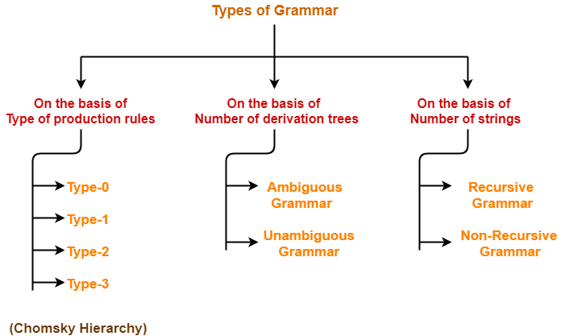

Slide 4
(LHS) a → b (RHS) is a production rule.
And, that is the basis of classification in Chomsky Hierarchy

Slide 5
Chomsky Hierarchy :
Comprises four types of languages and their associated grammars and machines.
Type 3: Regular Languages
Type 2: Context-Free Languages
Type 1: Context-Sensitive Languages
Type 0: Recursively Enumerable Languages

Slide 6
Type 3 : Regular Grammar
Type-3 grammars generate regular languages.
Type-3 grammars must have a single non-terminal on the left-hand side and a right-hand side consisting of a single terminal or single terminal followed by a single non-terminal.
The productions must be in the form X → a or X → aY
where X, Y ∈ N (Non terminal)
and a ∈ T (Terminal)

Slide 7
These languages generated by these grammars are be recognized by a Finite Automaton.
Example
X → ε, X → a | aY, Y → b

Slide 8
Type 2 : Context Free Grammar
Type-2 grammars generate context-free languages.
The productions must be in the form A → γ
where A ∈ N (Non terminal)
and γ ∈ (T ∪ N)* (String of terminals and non-
terminals).
These languages generated by these grammars are be recognized by a Pushdown Automaton.
Example :
S → X a X → a X → aX X → abc X → ε

Slide 9
Type 1 : Context Sensitive Grammar
Type-1 grammars generate context-sensitive languages. The productions must be in the form
α A β → α γ β
where A ∈ N (Non-terminal)
and α, β, γ ∈ (T ∪ N)* (Strings of terminals and non-terminals)
The strings α and β may be empty, but γ must be non-empty.
|LHS| <=|RHS| productions
The start variable S cannot appear on the RHS
The languages generated by these grammars are recognized by a Linear bounded automaton.
Example
AB → AbBc, A → bcA , B → b

Slide 10
Type 0 : Unrestricted Grammar
Type-0 grammars generate recursively enumerable languages.
The productions have no restrictions.
They are any phase structure grammar including all formal grammars.
They generate the languages that are recognized by a Turing machine.
The productions can be in the form of α → β where α is a string of terminals and non terminals with at least one non-terminal and α cannot be null. β is a string of terminals and non-terminals.
Example
S → ACaB , Bc → acB, CB → DB, aD → Db

Slide 11
Grammar Type | Grammar Accepted | Language Accepted | Automaton
Type 0 | Unrestricted grammar | Recursively enumerable language | Turing Machine
Type 1 | Context-sensitive grammar | Context-sensitive language | Linear-bounded automaton
Type 2 | Context-free grammar | Context-free language | Pushdown automaton
Type 3 | Regular grammar | Regular language | Finite state automaton

Slide 12
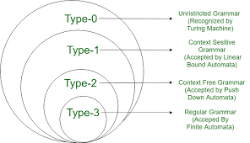

Slide 13
Closure Properties of CFL

Slide 14
Closure properties of CFL
Closure properties consider operations on CFL that are guaranteed to produce a CFL
The CFL’s are closed under union, concatenation, closure

Slide 15
Union
Let L₁ and L₂ be two context free languages. Then L₁ ∪ L₂ is also context free.
Use L= {a, b}, s(a) = L₁ and s(b)=L₂.s(L)= L₁∪L₂
To get grammar for L₁ ∪ L₂ ?
Add new start symbol S and rules S → S₁|S₂
We get grammar G = (V, T, P, S) where
V = V₁ ∪ V₂ ∪ { S }, where S ∉ V₁ ∪ V₂
P = P₁ ∪ P₂ ∪ { S → S₁ | S₂ }
Example:
L₁ = { a^{n}b^{n} | n ≥ 0 } , L₂ = { b^{n}a^{n} | n ≥ 0 }
G₁ : S₁ → aS₁b | ε, G₂ : S₂ → bS₂a | ε
L1 ∪ L2 is G = ({S₁, S₂ , S}, {a, b}, P, S) where P = {P1 ∪ P2 ∪ {S → S₁ | S₂ }}

Slide 16
Example
Let L₁ = { a^{n}b^{n} , n > 0}. Corresponding grammar G₁ will have P: S1 → aAb|ab
Let L₂ = { c^{m}d^{m} , m ≥ 0}. Corresponding grammar G₂ will have P: S2 → cBb| ε
Union of L₁ and L₂, L = L₁ ∪ L₂ = { a^{n}b^{n} } ∪ { c^{m}d^{m} }
The corresponding grammar G will have the additional production S → S1 | S2

Slide 17
Concatenation
If L₁ and L₂ are context free languages, then L₁L₂ is also context free.
Let L={ab}, s(a)=L₁ and s(b)=L₂. Then s(L)=L₁L₂
To get grammar for L₁L₂ ?
Add new start symbol and rule S → S₁S₂
We get G = (V, T, P, S) where
V = V₁ ∪ V₂ ∪ { S }, where S ∉ V₁ ∪ V₂
P = P₁ ∪ P₂ ∪ { S → S₁S₂ }
Example:
L₁ = { a^{n}b^{n} | n ≥ 0 } with G₁: S₁ → aS₁b | ε
L₂ = { b^{n}a^{n} | n ≥ 0 } with G₂ : S₂ → bS₂a | ε
L₁L₂ = { a^{n}b^{{n+m}}a^{m} | n, m ≥ 0 } with G = ({S, S₁, S₂}, {a, b}, {S → S₁S₂, S₁ → aS₁b | ε, S₂ → bS₂a}, S)

Slide 18
Example
Concatenation of the languages L₁ and L₂,
L = L₁L₂ = { a^{n}b^{n}c^{m}d^{m} }
The corresponding grammar G will have the additional production S → S1 S2

Slide 19
Kleene Closure
If L is a context free language, then L* is also context free.
Use L={a}* or L={a}⁺, s(a)=L₁. Then s(L)=L₁*
Example:
Let L = { a^{n}b^{n} , n ≥ 0}. Corresponding grammar G will have P: S → aAb| ε
Kleene Star L₁ = { a^{n}b^{n} }*
The corresponding grammar G₁ will have additional productions S1 → SS₁ | ε
To get grammar for (L₁)*
Add new start symbol S and rules S → SS₁ | ε.
We get G = (V, T, P, S) where
V = V₁ ∪ { S }, where S ∉ V₁
P = P₁ ∪ { S → SS₁ | ε}

Slide 20
Ambiguous Grammar | Unambiguous Grammar
A grammar is said to be ambiguous if for at least one string generated by it, it produces more than one- parse tree or derivation tree or syntax tree or leftmost derivation or rightmost derivation | A grammar is said to be unambiguous if for all the strings generated by it, it produces exactly one- parse tree or derivation tree or syntax tree or leftmost derivation or rightmost derivation
For ambiguous grammar, leftmost derivation and rightmost derivation represents different parse trees. | For unambiguous grammar, leftmost derivation and rightmost derivation represents the same parse tree.
Ambiguous grammar contains less number of non-terminals. | Unambiguous grammar contains more number of non-terminals.

Slide 21
For ambiguous grammar, length of parse tree is less. | For unambiguous grammar, length of parse tree is large.
Ambiguous grammar is faster than unambiguous grammar in the derivation of a tree. (Reason is above 2 points) | Unambiguous grammar is slower than ambiguous grammar in the derivation of a tree.
Example- E → E + E / E x E / id (Ambiguous Grammar) | Example- E → E + T / T T → T x F / F F → id (Unambiguous Grammar)

